Slide 1

Git and gerrit lunch and learn, Organized by the Women of openstack
Github repo - https://github.com/spotzz/AustinSummit/

Slide 2

Lunch and learn objectives
Learn the OpenStack Contribution Process
Gain Working Knowledge of Git and Gerrit

Slide 3


Presenters
Amy Marrich
Tamara Johnston

Slide 4



Room Support VOlunteers
Darius Smigiel
Elizabeth K. Joseph
Holly Bazemore
Jeff Olsen
Leong Sun
Khai Do
Shilla Saebi
Xing Yang

Slide 5
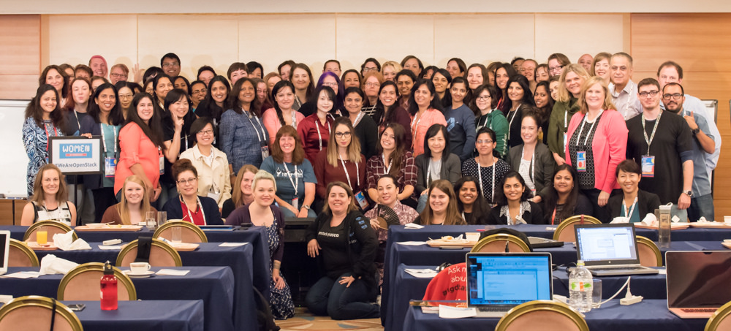
WOMEN OF OPENSTACK
Objectives
Increase Diversity of the Community
Develop Leadership Skills
Community Stats (Women)
9% Community Members
11% (24% ATCs) Tokyo Summit Attendees
Austin WOO Sessions - http://bit.ly/1UZaUo6
Image courtesy of the OpenStack Foundation

Slide 6
AGENDA
Why Contribute to The OpenStack Code Base
Pre-Requirements Review
OpenStack Contribution Process
Create, Triage, and Assign Documentation Bug
Create, Commit, and Verify Patch
Reference Materials

Slide 7






Why contribute to the openstack code base
Help Drive the Future of an OSS Project and Community
Vote During TC and PTL Elections
Free Pass to OpenStack Summit
Notes:
Full control to make changes/fixes that quickly/directly affect them/their organization.
Instantaneously have a seat at the table to help drive the change.
Having a direct hand introducing features or resolving issues in the OS code base.

Slide 8
Pre-requirements REVIEW
Please advise a room support member if you’ve not completed pre-requirements
✔ Joined OpenStack Community as Foundation Member
✔ Signed ICLA
✔ Created Launchpad Account
✔ Created Gerrit Account and Uploaded Public SSH Key

Slide 9
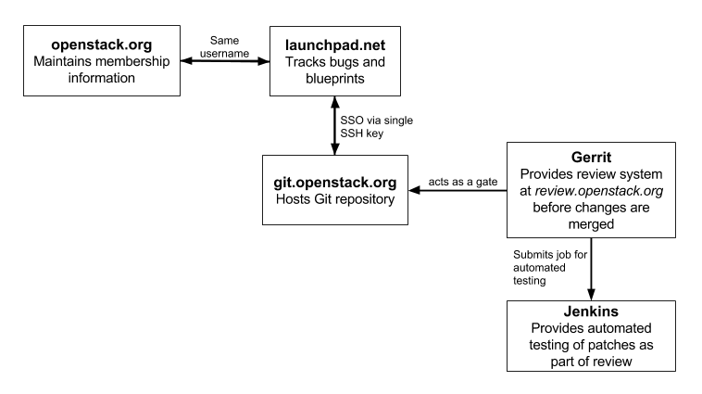
Openstack contribution process
Images courtesy of the OpenStack Foundation

Slide 10
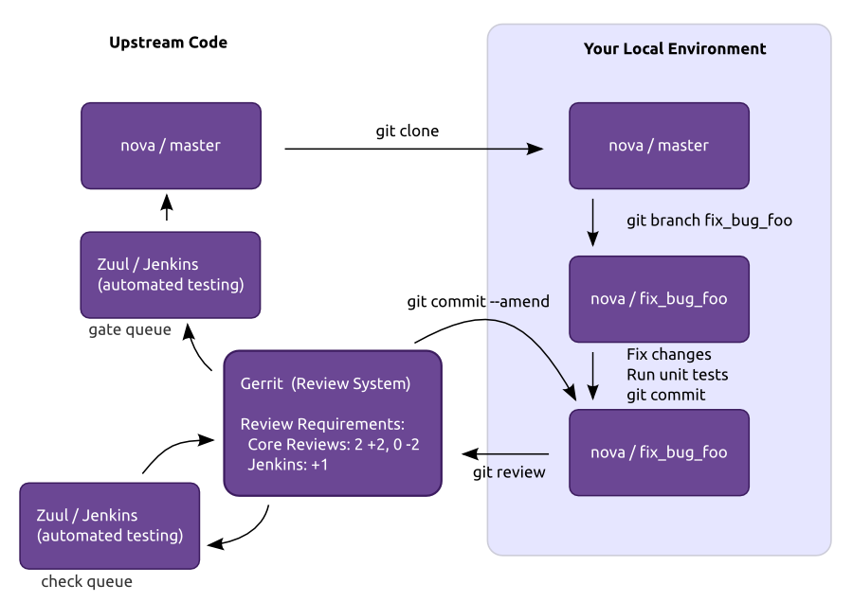
Openstack contribution process

Slide 11

Openstack bug system overview
URL - https://bugs.launchpad.net/openstack/
Login - Launchpad Account
When to Open or Assign a Bug
How Bugs Are Created
Manually
DocImpact Flag in Commit Message
Bug Triaging
Tips
Do not start work on a documentation bug until it is confirmed
Do not use Launchpad Answers, use Ask OpenStack

Slide 12

Create and assign docUMENTATION bug
URL - https://launchpad.net/austinlunchandlearn
Click “Report a Bug”
Enter Bug Summary (Brief Description)
Provide Further Information on the Bug
Extra Options
Status – New
Importance – Undecided
Assign Bug to Yourself
Images courtesy of the OpenStack Foundation

Slide 13
Configure git and GIT REVIEW
$ git config --global user.name "Firstname Lastname"
$ git config --global user.email "your_email@youremail.com"
$ git config --global gitreview.username yourgerritusername
$ git config –-list
Tip
“We don’t know where your gerrit is” Error? git remote add gerrit ssh://<username>@review.openstack.org:29418/openstack/sandbox.git

Slide 14
Clone openstack SANDBOX repo and create branch
$ git clone https://git.openstack.org/openstack-dev/sandbox.git
$ cd sandbox/
Setup git review
Mac/Ubuntu - $ git review –s
Windows - $ git review
$ git remote update
$ git checkout master
$ git pull –-ff-only origin master
$ git checkout –b bug/bugID
Tip
Commit Message Best Practices - https://wiki.openstack.org/wiki/GitCommitMessages

Slide 15
Create, Commit, and verify patch
$ cat > mytestfile << EOF
Add text unique to your file
$ git status
$ git add mytestfile
$ git status
$ git commit –a
$ git commit –-amend
$ git show
$ git review
Tip
Commit Message Best Practices - https://wiki.openstack.org/wiki/GitCommitMessages

Slide 16
Gerrit and jenkins workflow review
Gerrit - https://review.openstack/org/#/c/<ID>
Gate Checking - http://status.openstack.org/zuul/

Slide 17
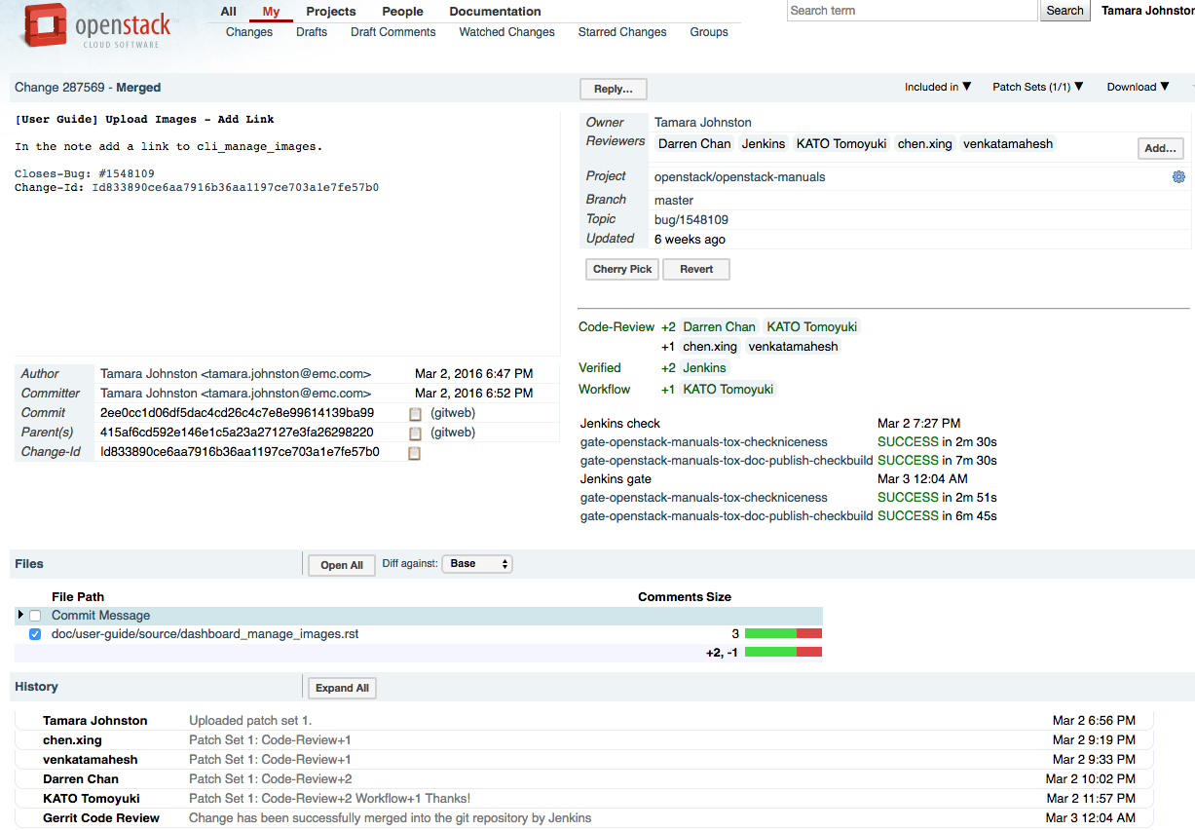
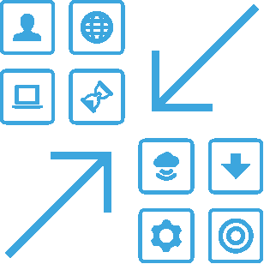

Gerrit review

Slide 18
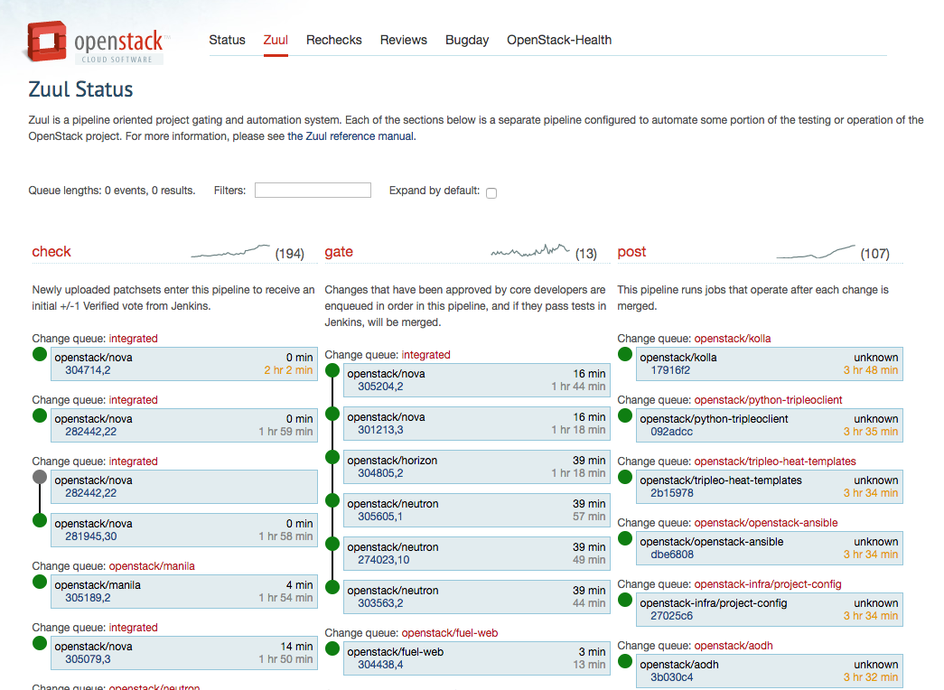
Zuul StatuS

Slide 19
Additional exercise – Edit Patch
Edit File
$ git add filename
$ git commit –a --amend
$ git review

Slide 20
Additional exercise – Create Patch dependency and rebase
$ git pull origin master
(updates your local version of the master branch)
$ git checkout <your_branch>
$ git rebase –i master
$ git rebase --continue

Slide 21
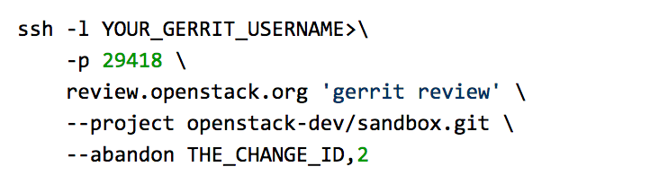
Abandon commit

Slide 22
Where to find help
Ask OpenStack - https://ask.openstack.org
IRC
https://wiki.openstack.org/wiki/IRC /
http://docs.openstack.org/upstream-training/irc.html
Mail Lists - https://wiki.openstack.org/wiki/Mailing_Lists

Slide 23
Reference materials
Contributors Guide - http://docs.openstack.org/contributor-guide/
First Time Contributors QuickStart Guide - http://docs.openstack.org/contributor-guide/first-timers-quickstart.html
Documentation Bugs - http://docs.openstack.org/contributor-guide/doc-bugs.html
Learn The Gerrit Workflow in the Sandbox - http://docs.openstack.org/infra/manual/sandbox.html

Slide 24
Reference materials
Commit Messages - https://wiki.openstack.org/wiki/GitCommitMessages
Testing - https://wiki.openstack.org/wiki/Testing
Setup and Learn Git http://docs.openstack.org/upstream-training/git.html

Slide 25


